Slide 1










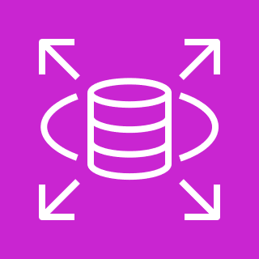
AWS Cloud
VPC
Internet gateway
Public subnet
Private subnet
Private subnet
Internal ELB
NAT gateway
Application
Instance
Auto-Scaling
Multi-AZ
External ELB
RDS
Web Instance

